Slide 1

Chatter
Team: Elite Three

Slide 2
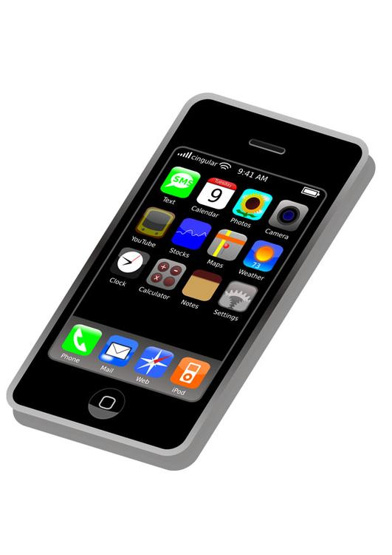
Problem Statement
Many communication applications are often so complex as to alienate new users
The vision of Chatter is to create a simple, transparent mobile messaging application which addresses this concern
This system shall
allow users to communicate simply
Include a website which clearly explains how user data is handled
encourage user feedback

Slide 3

Objectives
Create a functional mobile messaging application
Utilize the tools of iOS development
Use HTML, CSS, and PHP to develop a website
Create meaningful documentation to describe the Chatter system
Present results using effective presentation aids

Slide 4

Key Contributions
Identifier | Description | Complete? | Comment | Developed By
REQ1 | The system shall allow text-based messages to be sent between users | Yes | High priority Requirement. Database integration more complex than expected. | Sam
REQ3 | The system shall provide a website which details operation of the Chatter application | Yes | Completed early in process. Made to function with different screen sizes. | Mary
REQ1-REQ9 | Formal documentation | Yes | Documentation of Requirements, User Stories, Use Cases | Brandon

Slide 5

Key Contributions
Identifier | Description | Complete? | Comment | Developed By
REQ4 | The system shall provide a feedback mechanism which encourages user feedback. | Yes | Important feature for the continuing maintenance of Chatter. | Mary
User Story ST-1 | As a new user, I want to quickly create an account so I can send messages. | Yes | Includes both traditional account creation as well as “facebook login” feature. | Sam
Test Plans | How to effectively test the Chatter system | Yes | Developed Unit Tests, Integration Testing Plans, System Testing Plans | Brandon

Slide 6
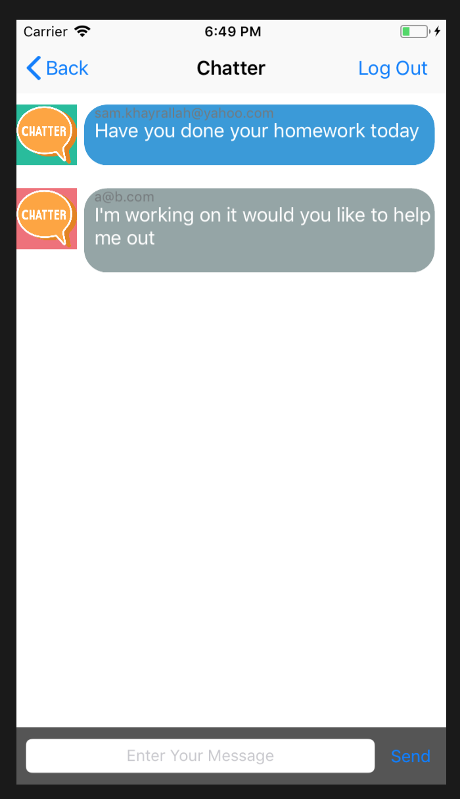
Demo

Slide 7
Project Issues
Open Issues
Password Protecting Communication
Heavy Load Testing
Virtualizing many iOS devices simultaneously
Waiting Room
Reset Password (UC-11)
Complexity of Implementation vs. Value to Customer
Project Retrospective
The Chatter project has been successful. We’ve created both a functioning iOS application and a useable website. The efficient development of the Chatter system can be attributed to an effective planning phase, and the adoption of the incremental process.

Slide 8

Questions?

